Slide 1
Data-driven ballast layer evaluation and prediction based on machine learning models
Bin Feng

Slide 2
Movement Only Clustering

Slide 3
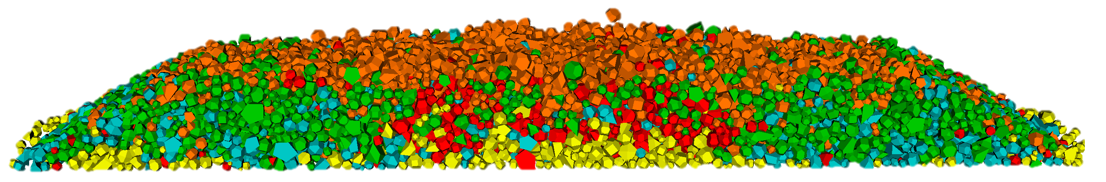
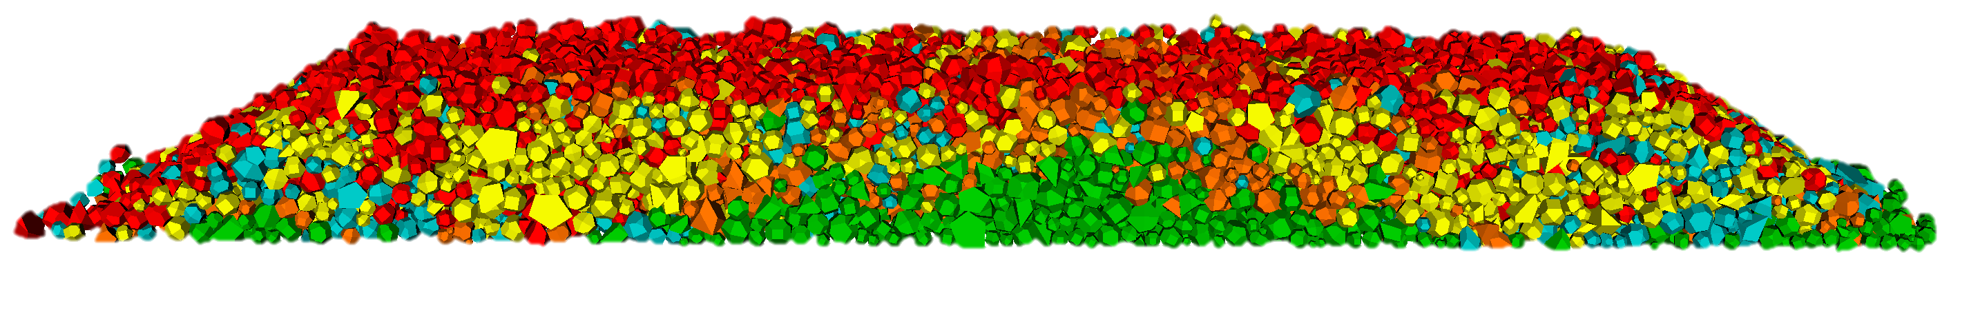
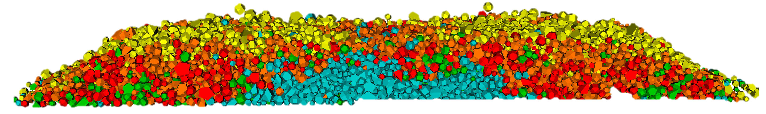
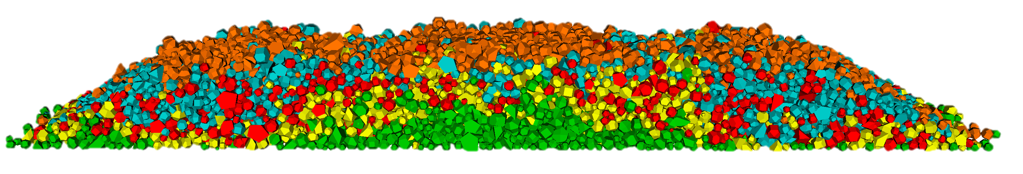
Movement Only Clustering
Center Binding
Full Support
Lack of Center Support
Lack of Rail Seat Support

Slide 4
Force Only Clustering

Slide 5
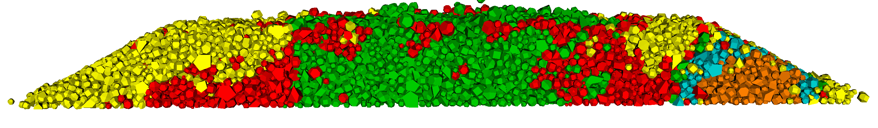
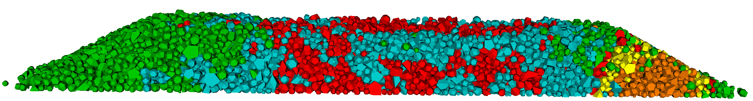
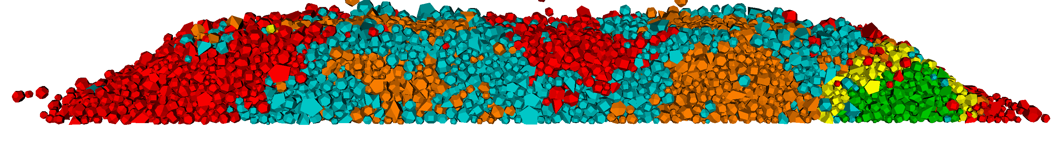
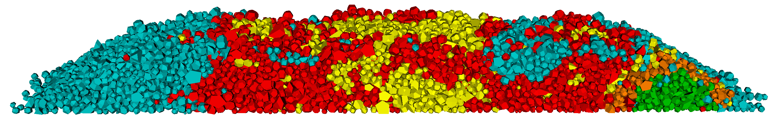
Force Only Clustering
With Bugs
Center Binding
Full Support
Lack of Center Support
Lack of Rail Seat Support

Slide 6
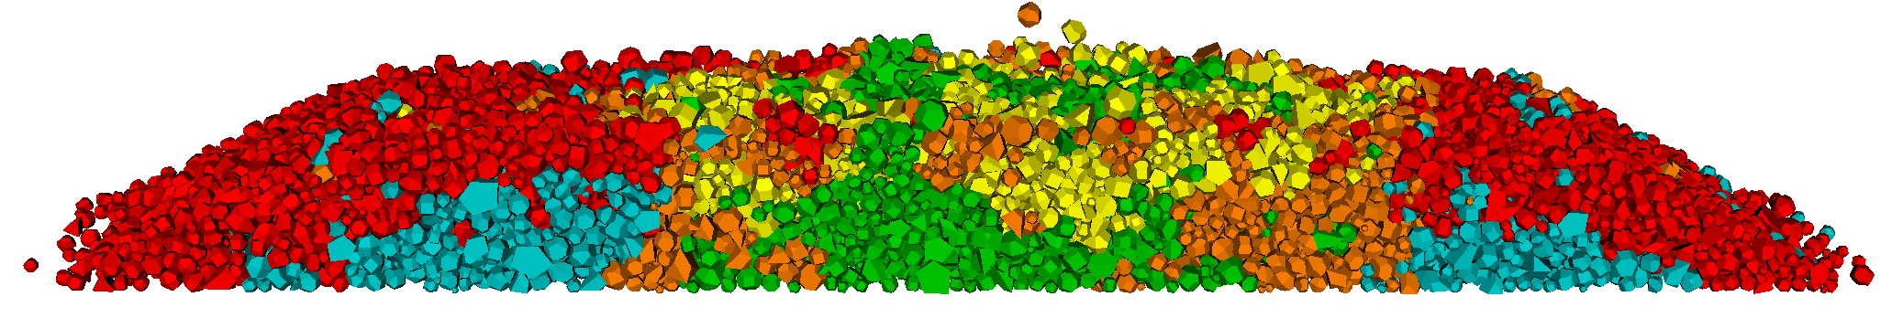
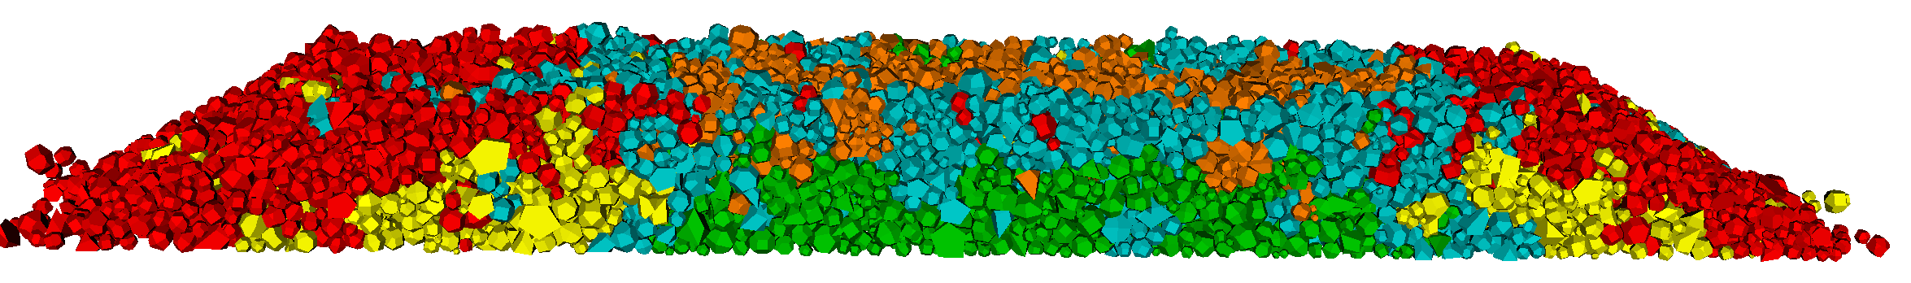
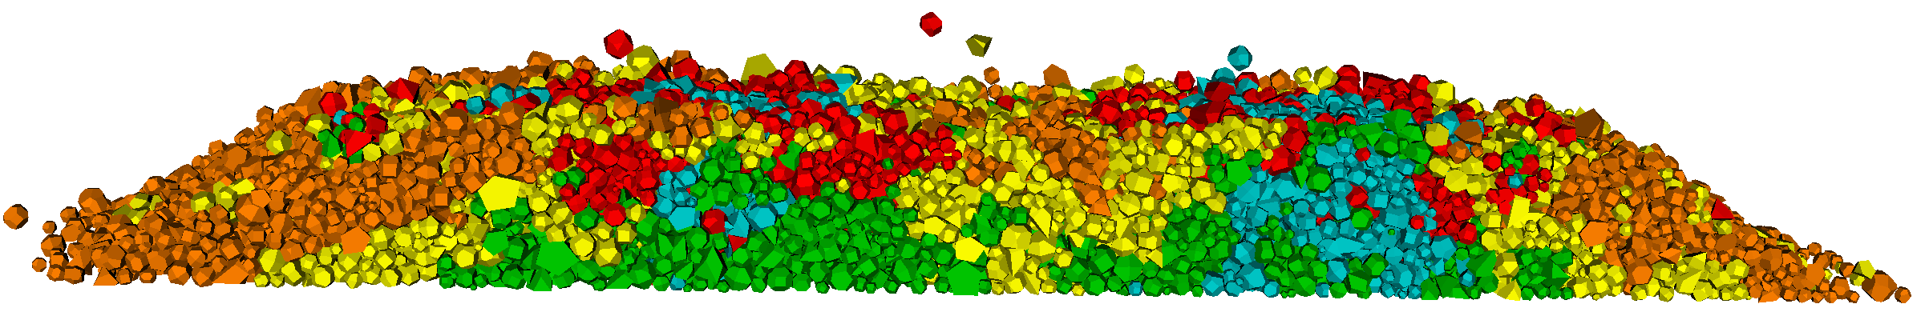
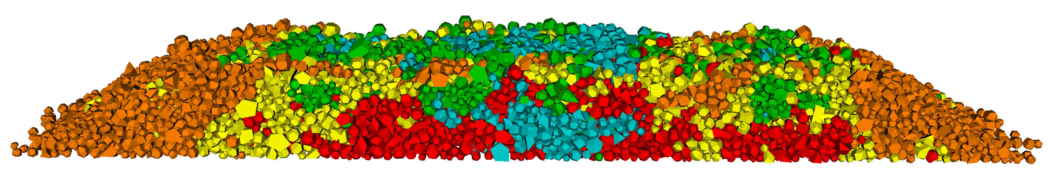
Force Only Clustering
Without Bugs
Center Binding
Full Support
Lack of Center Support
Lack of Rail Seat Support

Slide 7
Force + Movement Clustering

Slide 8
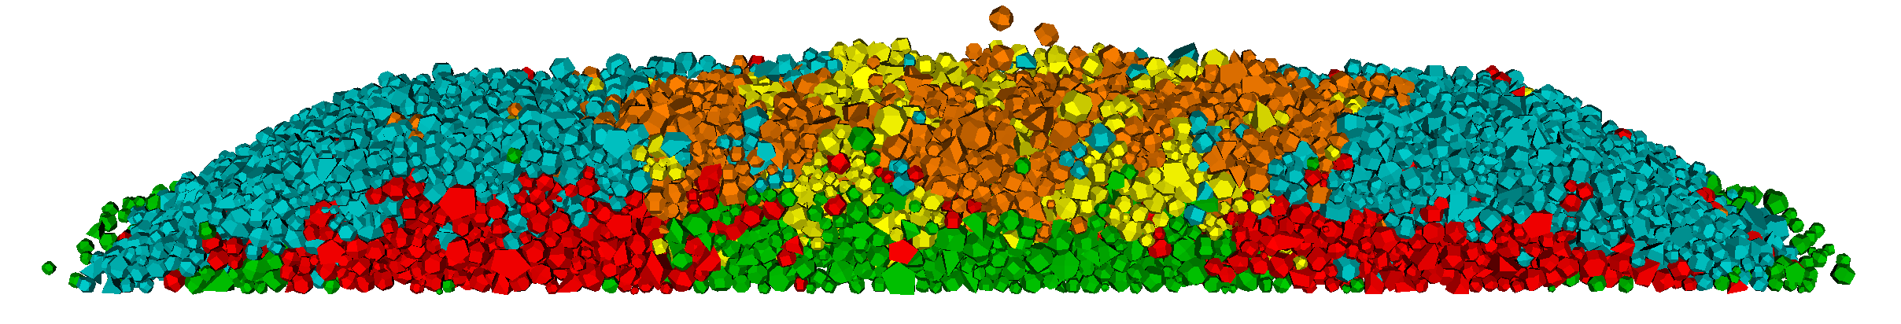
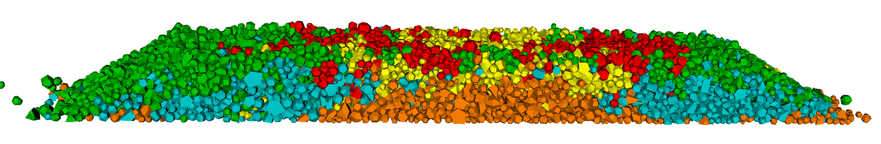
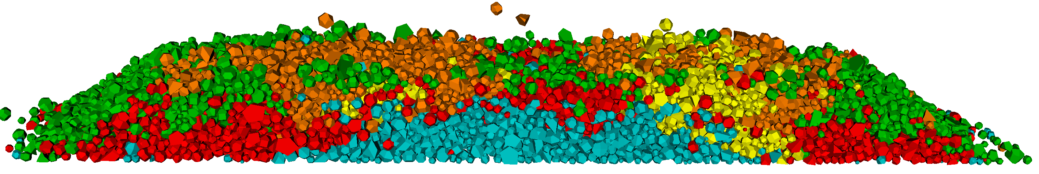
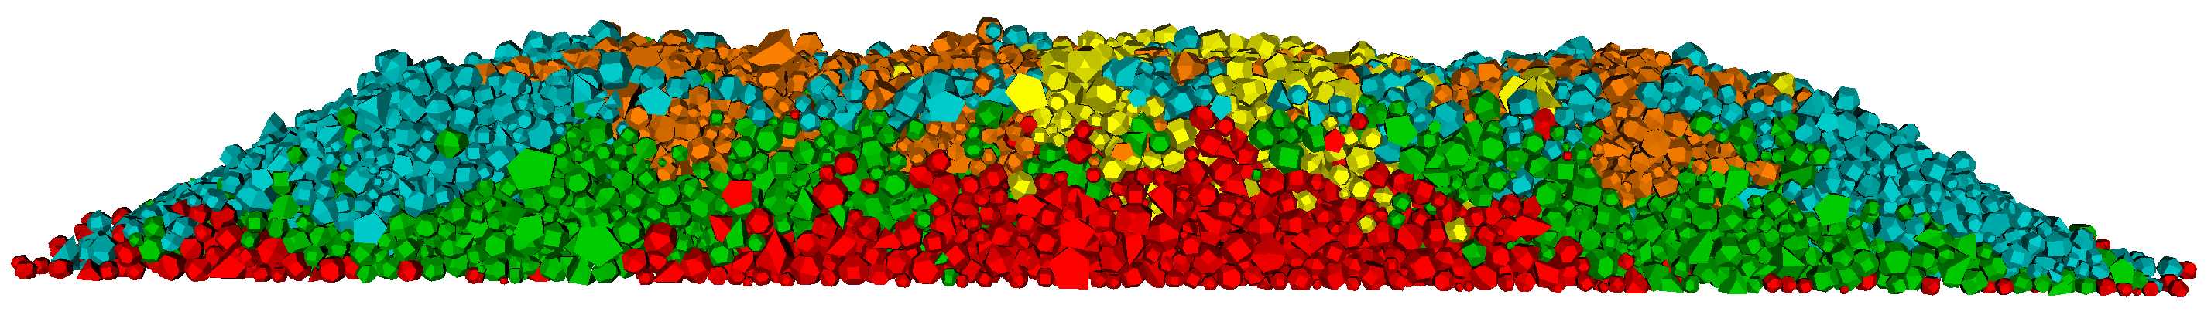
Force + Movement Clustering
Center Binding
Full Support
Lack of Center Support
Lack of Rail Seat Support

